Slide 1



Warm temperatures and COPD hospitalisations in England
Joint Training Programme - Annual Training Day
22 September 2022
Garyfallos Konstantinoudis
Biostatistics and Data Science / Minelli C, Vicedo-Cabrera AM, Ballester J, Gasparrini A, Blangiardo M

Slide 2
Introduction

Slide 3
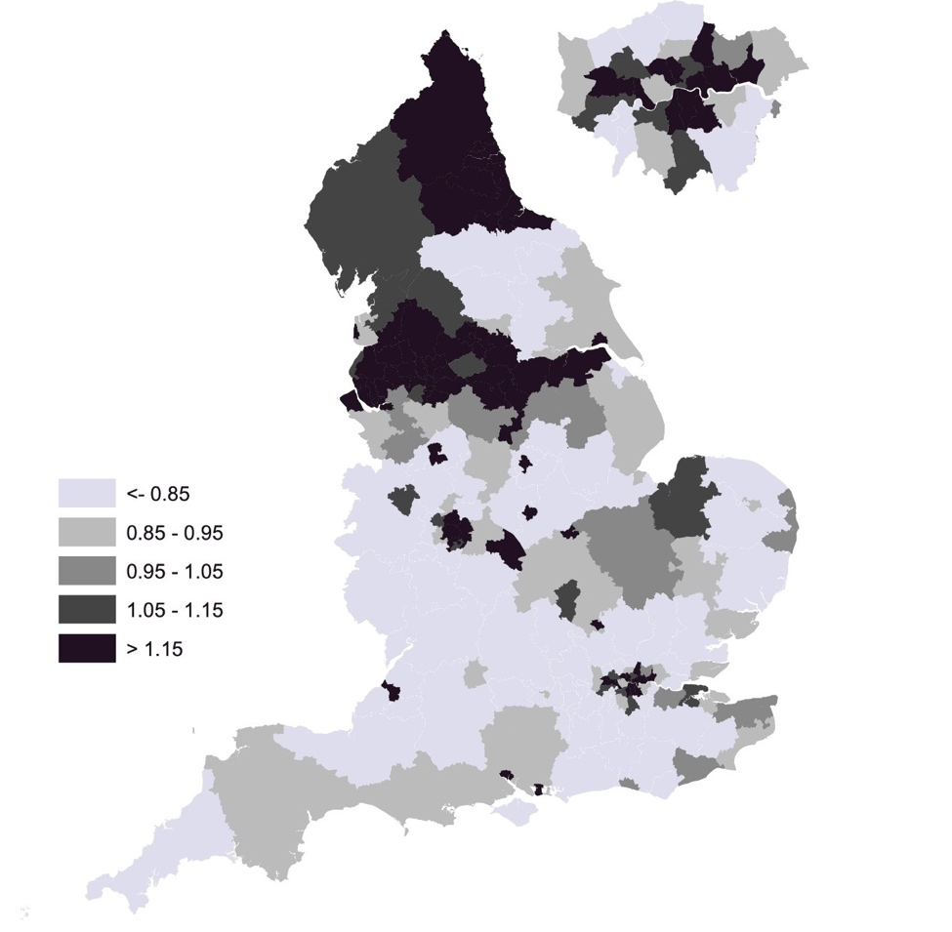
COPD burden
3rd cause of death, 3.17 million deaths in 2015 globally.
In England, 115,000 emergency admissions and 24,000 deaths per year.
COPD exacerbations: Bacteria, viruses and air-pollution.
The role of temperature is unclear.

Slide 4
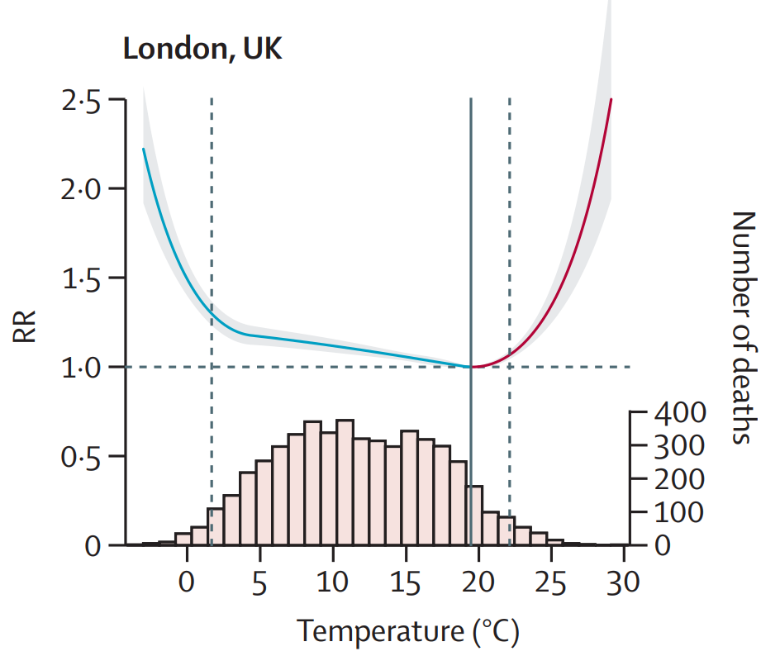
Temperature
U-shaped relationship between temperature and health.
Cold, dry air or hot air can trigger a flare-up.
Different confounding, different lags across different temperatures.
This study focuses on warm temperatures.

Slide 5
Previous studies -- Aim
Authors | Aggregation | Country | Pollutants | Effect
Michelozzi 2019 et al | City & daily | EU | NO₂, O₃ | 2.1 (0.6, 3.6) per 1ºC
Anderson 2013 et al | County & daily | US | O₃, PM₁₀, PM_{2.5} | 2.0 (0.4, 4.5) per 10ºF
Zhao 2019 et al | Individual | Brazil | none | 5.0 (4.0, 6.0) per 5ºC
Spatial & temporal aggregation
Exposure varies on high resolution.
Ecological bias
Aim: Examine the effect of heat exposure on COPD hospitalization risk in England and how this varies by age, sex and spatial covariates.

Slide 6
Methods

Slide 7
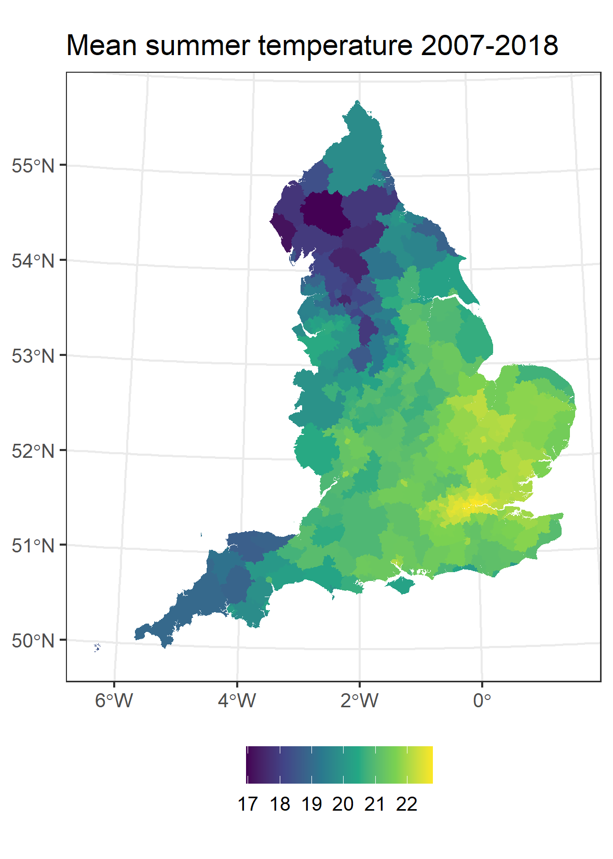
Outcome and Exposure
Outcome
NHS digital & SAHSU.
COPD hospitalization (ICD10 J40-44) 2007-2018.
Individual data/ 100m grid spatial resolution.
Summer months.
Exposure
Daily maximum temperature 2007-2018 at 1km grid from MetOffice.
lag0-2.

Slide 8
Case-cross over design
Epidemiological study design for transient environmental exposures
Sample from same month and days
Exposure period 0-2 days before the hospital episode (mean temperature)

Slide 9
Covariates
Covariates | Source | Space | Time | years
Holidays | ONS | nationwide | daily | 2007-2018
Relative Humidity | MetOffice | 10km x 10km | daily | 2007-2018
PM_{2.5} | MetOffice | 2km x 2km | daily | 2007-2018
O₃ | MetOffice | 2km x 2km | daily | 2007-2018

Slide 10
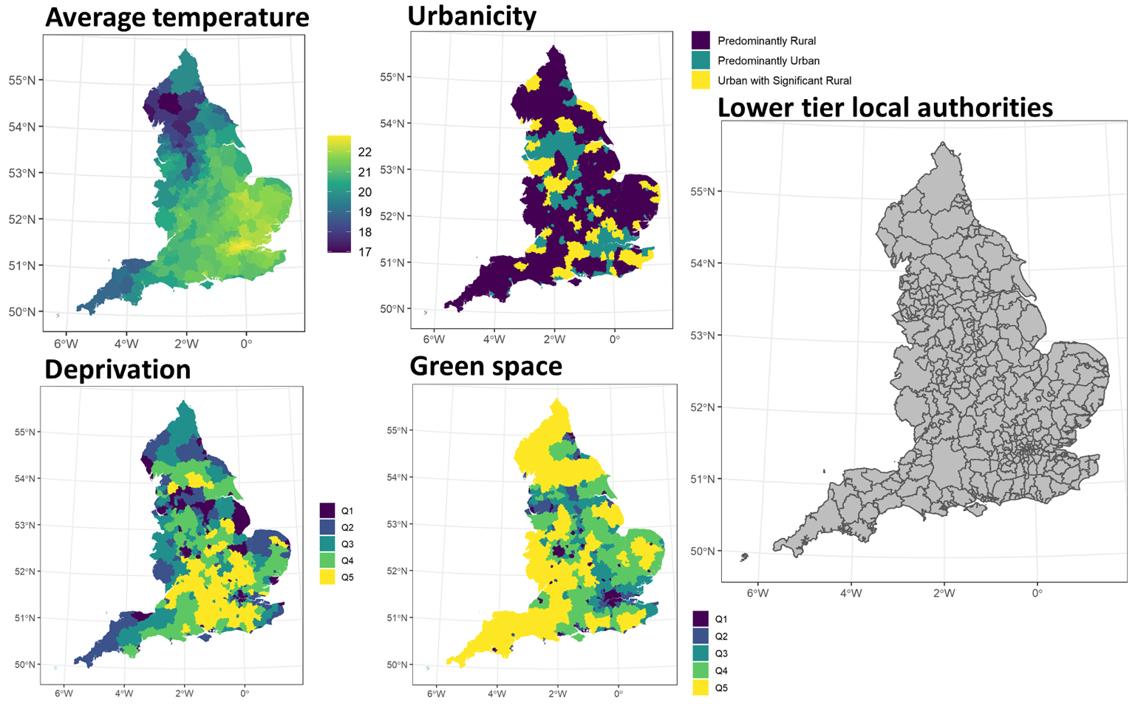
Spatial covariates

Slide 11
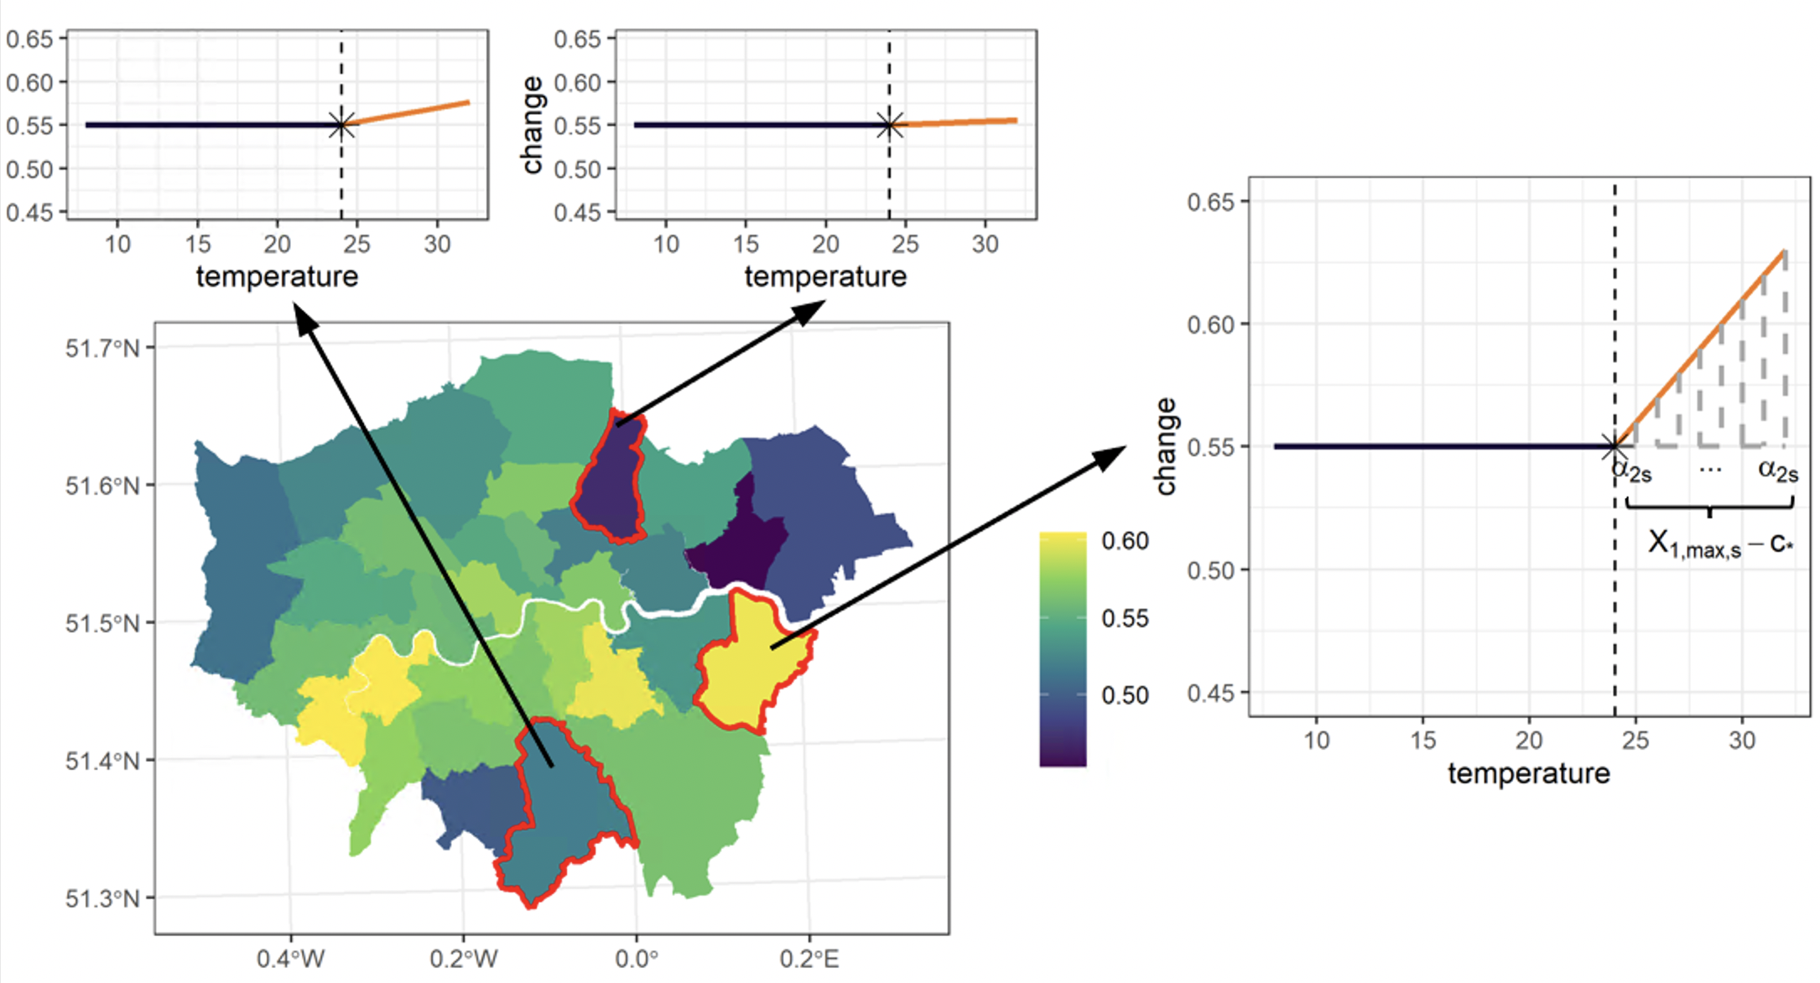
Statistical analysis
Step 1: Linear threshold model
Step 2: Age and sex effect modification.
Step 3: Spatial effect modification.
Average temperature
Urbanicity
Deprivation
Green space

Slide 12
Results

Slide 13
Effect modification by age and sex
Threshold 80-th percentile: 23.2ºC
Per 1ºC in temperatures higher than 23.2ºC

Slide 14
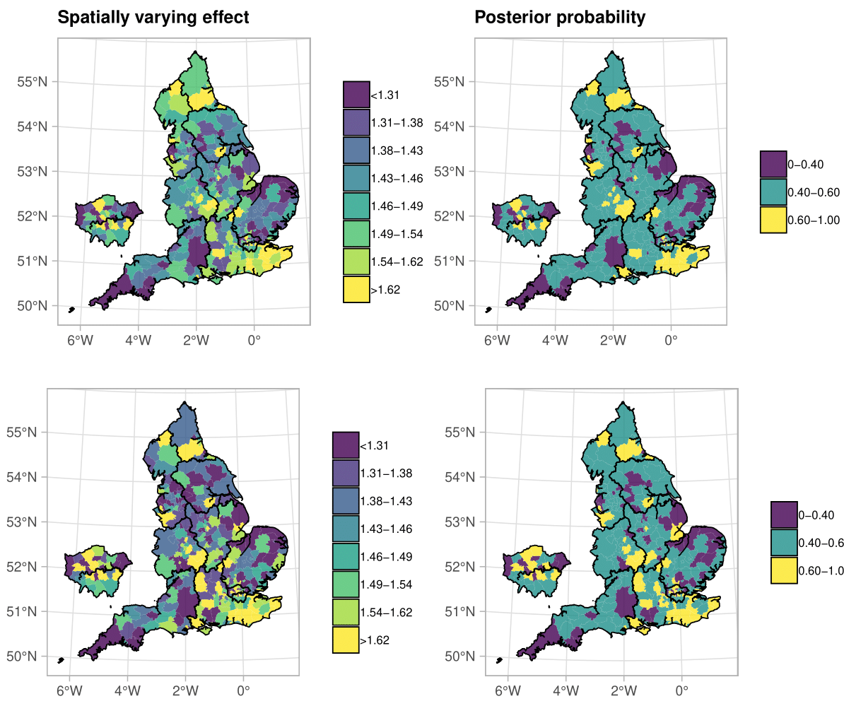
Spatial Effect
Evidence of spatial variation.
Green space and average temperature protective effects.
Vulnerabilities persist after accounting for spatial effect modifiers

Slide 15
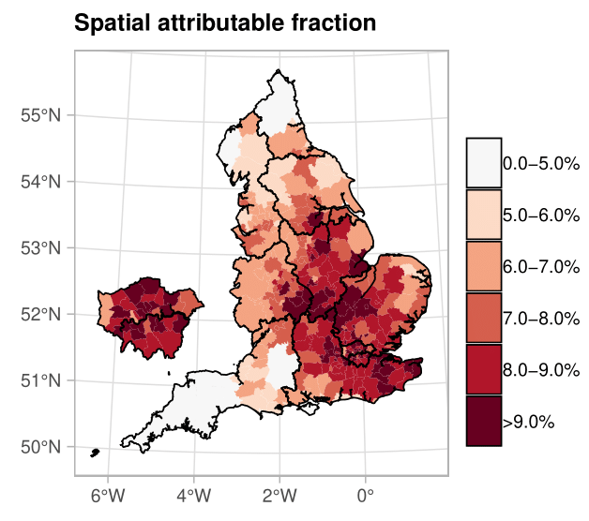
Population attributable fraction
1851 (1576, 2079) COPD hospitalisations attributable to warmer temperature annually.
7.8% (6.7%, 8.8%) of the total COPD hospitalisations during summer months.
Populations in East Midlands, East of England, London and South-East contribute most.

Slide 16
Discussion

Slide 17
Summary of the results – Take home message
1.46% (1.19%, 1.71%) for every 1ºC increase in warm temperatures.
Adjusting for air-pollution weakens evidence of an effect.
Weak evidence of an effect modification by sex and age, whereas strong spatial component.
Take home message
Evidence that COPD hospitalisations increase with warmer temperatures and as temperatures consistently increase, public health systems should be alerted and prepared to challenge the increased COPD hospitalisation burden.

Slide 18


Questions?
Github: https://github.com/gkonstantinoudis/COPDTempSVC
Twitter: @konstantinoudis
Konstantinoudis G, et al Ambient heat exposure and COPD hospitalisations in England: a nationwide case-crossover study during 2007–2018. Thorax 2022.

Slide 19

Feedback to the course

